Slide 1


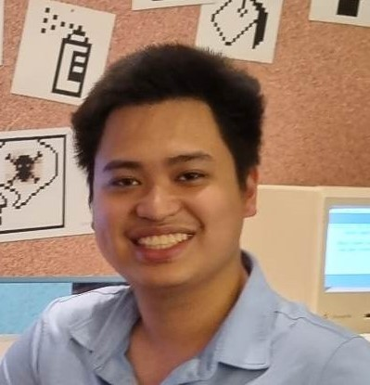
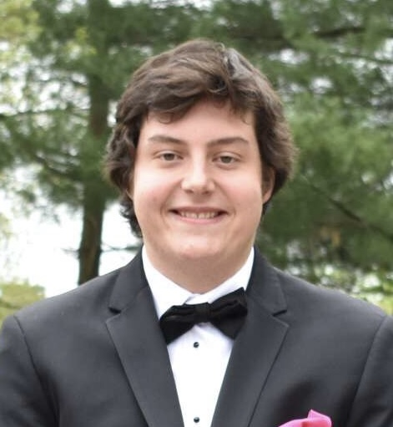
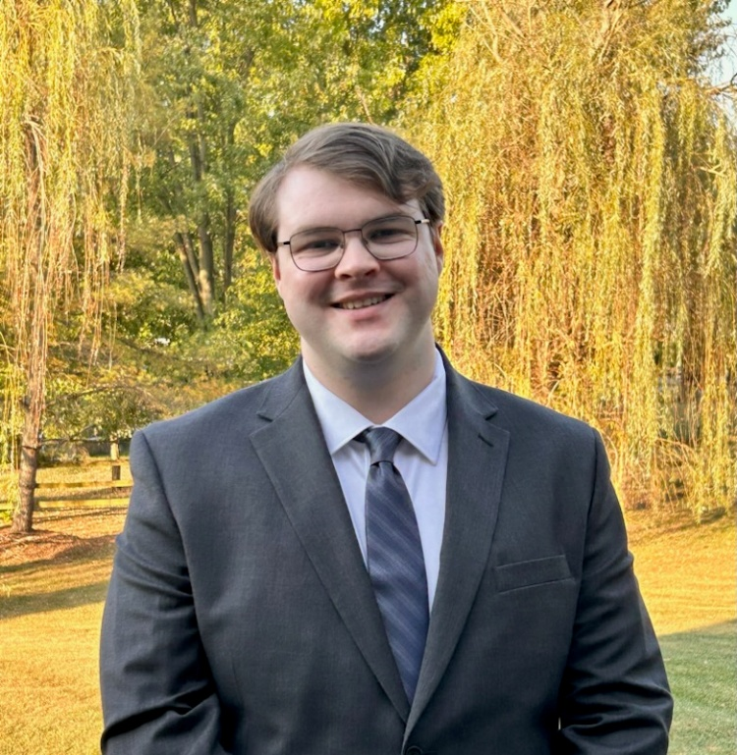

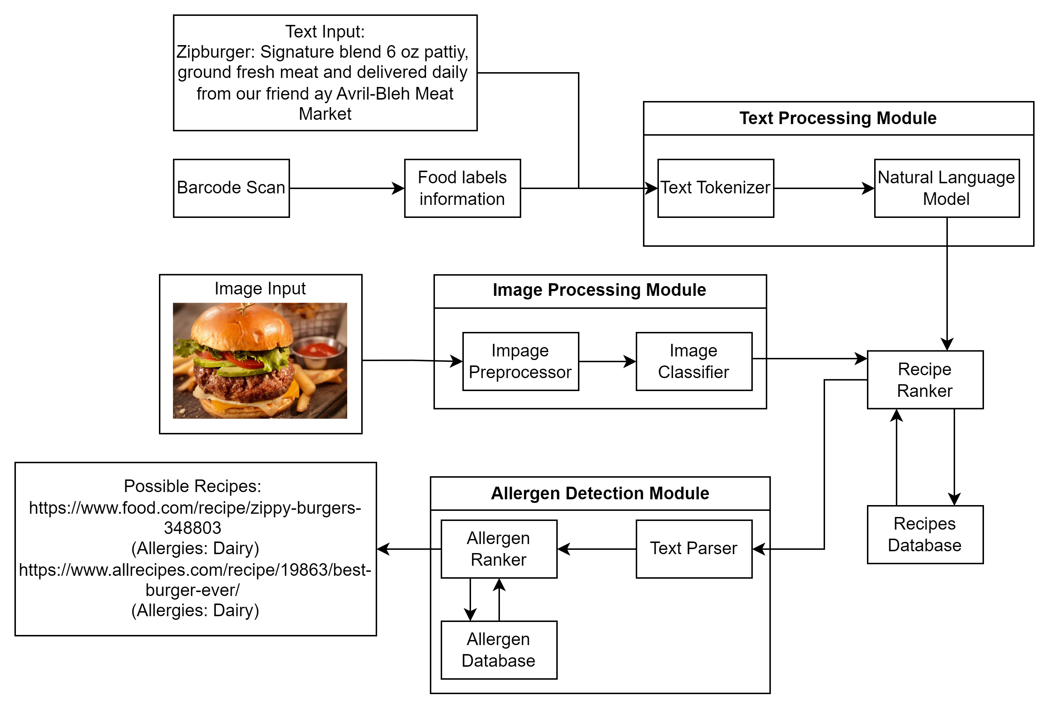






QSine
AI-Powered
Allergen Detection
Professor
Annexstein
Hung
Nguyen
Eric
Buffington
Matthew
Bryant
Kaleb
Bishop
Team
QSine System
Technologies
Team Members (Computer Science):
Kaleb Bishop – Frontend Lead
Hung Nguyen – Data Science Lead
Eric Buffington – Testing Lead
Matthew Bryant – Database Lead
Advisor:
Professor Annexstein – CEAS Professor
Product
QSine is an AI-powered mobile and web application designed to help individuals manage food allergies and make safer food choices. Our application helps those who are traveling, or with food sensitivities. By uploading a photo, scanning a barcode, or entering text, QSine analyzes the content and provides allergen information tailored to your preferences.
Challenges
Web scraping led to inconsistent food images.
Web scraping had many different variations of recipe pages with different parsing requirements.
Barcode database has many inconsistent or missing entries.
Cleaning data is a monstrous task when online recipes are very personal.
Achievements
Functional mobile app prototype with barcode scanning and YOLO powered ai image classification.
User-customizable allergens for more personalized results.
Positive initial feedback from friends and family.
Ongoing improvements based on user feedback to enhance accuracy and usability.
Goals & Impacts
User Stories
Food Safety – Reduce allergy risks by providing fast and accurate allergen detection.
Empower Users – Give individuals, parents, and caregivers confidence in making safe food choices.
Support Travelers – Enable easy allergen identification in foreign menus using text and image analysis.
For Individuals with Food Allergies
"I want to scan a menu for potential allergens so that I can confidently decide what to order without risking an allergic reaction.“
For Frequent Travelers with Allergies
"I want to quickly analyze foreign menus for potential allergens using text or image input so that I can make safe dining choices in unfamiliar places."

